Slide 1
Propensity Scores
Claire Miller
Tim Vigers
Elizabeth Wynn

Slide 2
Why use propensity score methods?
Randomized controlled trials (RCTs) are considered the gold standard of study design
Non-randomized observational studies are less expensive and easier to conduct
Problems that arise in non-randomized studies:
Selection bias
Confounding
Difficult to establish causal relationship between exposure and outcome

Slide 3
Why use propensity score methods?
Propensity score methods offer a solution to reduce effects of selection bias and confounding
Seek to mimic RCTs through analysis and interpretation of results
Allows for conclusions to be drawn about causal relationship between treatment/exposure and outcome

Slide 4
What are propensity scores?

Slide 5
Method and Process
Motivating Example using R:
400 male heart attack patients
Some treated with new drug (trt=1), and rest received standard care (trt=0)
Outcome variable is 30-day mortality (death=1)
Covariates: age, admission severity, risk score

Slide 6
Selecting Baseline Covariates

Slide 7
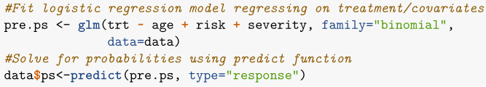
Estimating Propensity Scores
The most common method for estimating PS is logistic regression of treatment group on the selected covariates.
Estimated PS is the predicted probability of treatment from the regression model:

Slide 8
Alternative Estimation Methods
Setoguchi et al. “simulated data for a hypothetical cohort study (n = 2000) with a binary exposure/outcome and 10 binary/continuous covariates with seven scenarios differing by non-linear and/or non-additive associations between exposure and covariates.”
Compared logistic regression (LR) to recursive partitioning without pruning (RP1), RP with pruning (RP2), and neural networks (NN).
NN and RP1 generally performed better based on C-index

Slide 9
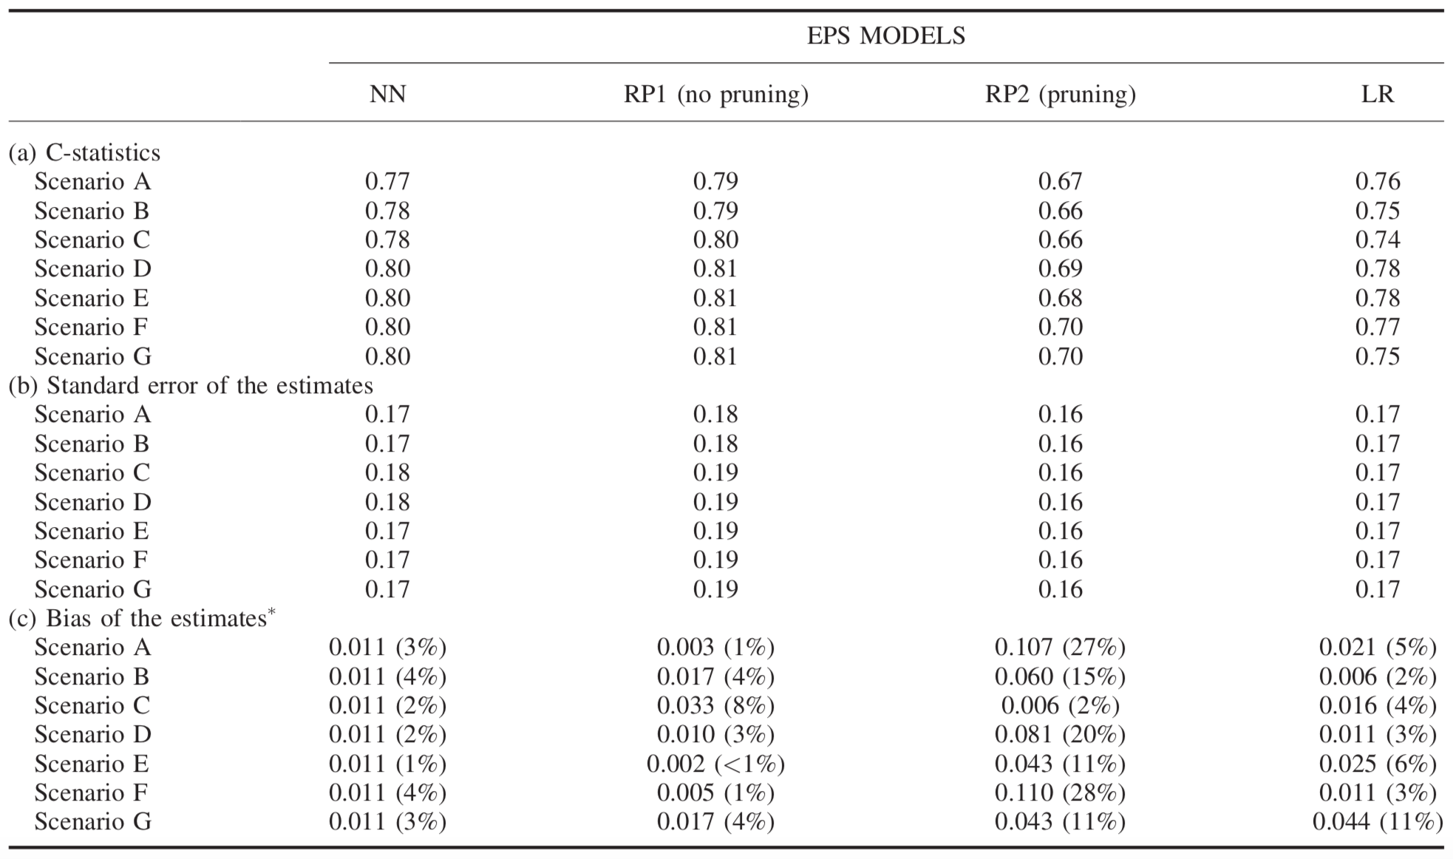
Alternative Estimation Methods

Slide 10
Alternative Estimation Methods
Lee et al. tested machine learning “ensemble methods of bagged CART, random forests, and boosted CART propensity score models” against logistic regression.
They found that logistic regression performed well with only main effects in the model, but that “the bias reducing capabilities of logistic regression propensity score models substantially degraded when the models did not account for interactions and non-linearities.”

Slide 11
Alternative Estimation Methods
Machine learning and data mining techniques do appear to slightly outperform logistic regression, but it’s questionable how much better they really are.
Is it worth setting up a neural network for a c-index of 0.77 instead of 0.76?
There is also some evidence that while c-index is a good indicator of how well the PS model discriminates between treated and untreated, it may not necessarily tell you whether the PS model is correct.

Slide 12
Estimation Model Assumptions
All PS models have two big assumptions:
That all variables which could potentially affect treatment assignment have been measured.
This is also an assumption with regression approaches for estimating treatment effect, and not unique to PS
Every subject has a nonzero chance of receiving either treatment.

Slide 13
Propensity Score Methods
There are a huge number of ways to match participants based on PS. (P.C. Austin’s 2014 paper in Statistics in Medicine compares 12 different algorithms)
The most common methods are:
1 to 1 pair matching (most common)
Many to 1 matching
Stratification
Inverse probability of treatment weighting (IPTW)

Slide 14
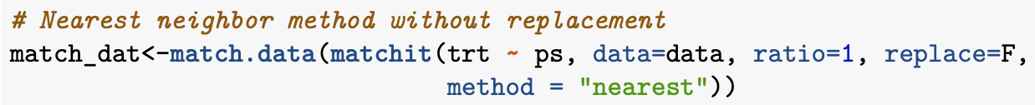
One to One Matching
With vs. without replacement
Without replacement ensures that each control is matched once at most
With replacement means that a control could be in multiple sets
Analysis must account for multiple matches

Slide 15
One to One Matching
Greedy vs. optimal matching
With greedy matching, a treated subject is picked at random, and matched with the closest control subject.
Does not matter if the control subject might be better matched to another treated subject.
Done until either the treated or control list is exhausted.
Optimal matching tries to minimize the total difference within pairs.

Slide 16
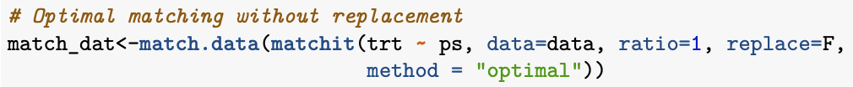
One to One Matching
One study (Gu & Rosenbaum, 1993) found that optimal matching was actually no better than greedy matching.

Slide 17
Nearest Neighbor Matching
How do you define a “close” propensity score?
Nearest neighbor matching selects the control subject with the closest PS, regardless of how close the scores actually are.
If there are multiple options with the same score, one is selected at random.
No restrictions on maximum difference

Slide 18
Caliper Matching
Matching within caliper distance is similar to nearest neighbor matching, but the difference between PS must be within a predefined threshold (the caliper).
If there are no control subjects within the caliper, the unmatched treatment subject is excluded.

Slide 19
Caliper Matching
What is a good maximum distance for caliper matching?
No generally agreed upon threshold
There are “theoretical arguments for matching on the logit of the propensity score, as this quantity is more likely to be normally distributed, and for using a caliper width that is a proportion of the standard deviation of the logit of the propensity score.” (Austin, 2011a)
A caliper that is 0.2 of the pooled standard deviation of the logit of the propensity score eliminates 99% of bias.

Slide 20
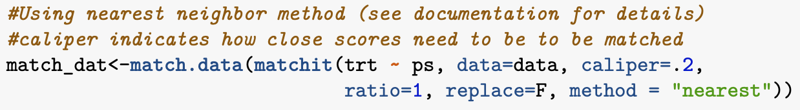
Caliper Matching
This sounds like sort of a pain, but the MatchIt package does everything for you:

Slide 21
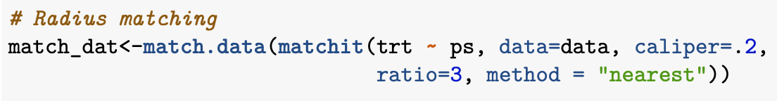
Many to One Matching
The process of M:1 matching is exactly the same as 1:1, but instead of choosing the single nearest neighbor, you pick multiple matching controls for each treated subject.
M:1 matching within a caliper is called radius matching.

Slide 22
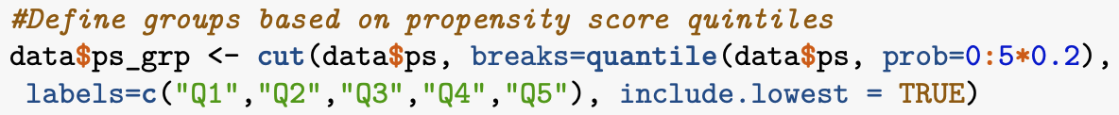
Stratification
Group subjects into subsets by propensity score
Rank by score, then split into a predefined number of levels
Generally 5 groups is a good rule of thumb
Eliminates about 90% of bias
More groups only improves bias marginally

Slide 23
Stratification
Each strata can be treated like a separate RCT.
Estimate treatment effect (differences in means or risk differences) in each group, and then average them.
Usually weighted by the number of participants in each group.
Same general approach for variance estimation, although this gets more complicated.
Can use regression adjustment within each group if there are still some differences based on treatment assignment.

Slide 24
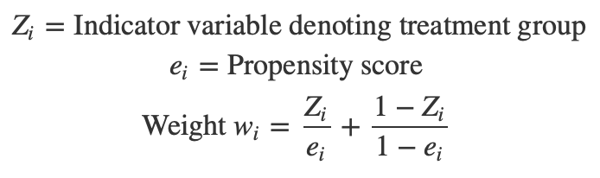
Inverse Probability of Treatment Weight (IPTW)
Each subject is given a weight equal to the inverse probability of receiving the treatment that subject actually received.
This allows calculation of the average treatment effect by comparing average weighted outcomes between treated and control groups.

Slide 25

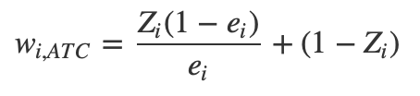
IPTW
Average treatment for the treatment and control groups can be calculated separately using different stabilized weights.
Treatment group:
Control group:

Slide 26

IPTW
Weighting regression models using IPTW is part of a family of causal inference methods called the marginal structure model.
Too complicated to go into detail, but there is a lot of research on these techniques.
Lots of estimation methods for IPTW, which need to take the weighted sample into account.

Slide 27

Covariate Adjustment
Outcome is regressed on propensity score and treatment indicator variable using linear regression (continuous outcome) or logistic regression (binary outcome).
Treatment effect is estimated from model coefficient of the treatment indicator variable
Example code:

Slide 28
Checking Balance Diagnostics
After applying propensity score method check that there aren’t systematic differences between groups for each covariate.
Matching, stratification, and IPTW use similar methods:
Matching: check balance between treatment groups in matched sample,
Stratification: check balance between treatment groups in individual strata
IPTW: check balance between treatment groups using the weighted sample.
Many different methods of assessing goodness of fit for propensity score adjusted regression models (See Austin, 2008)

Slide 29

4. Balance Diagnostics: Standardized Difference
Metric used to measure the difference in covariate between two groups:
Good rule of thumb: d<0.1

Slide 30
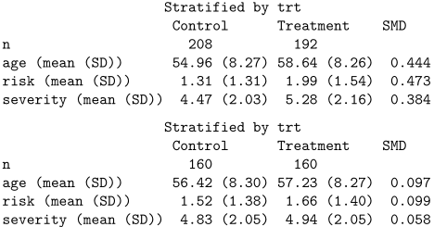
Standardized Difference Example
Using matched samples from before

Slide 31
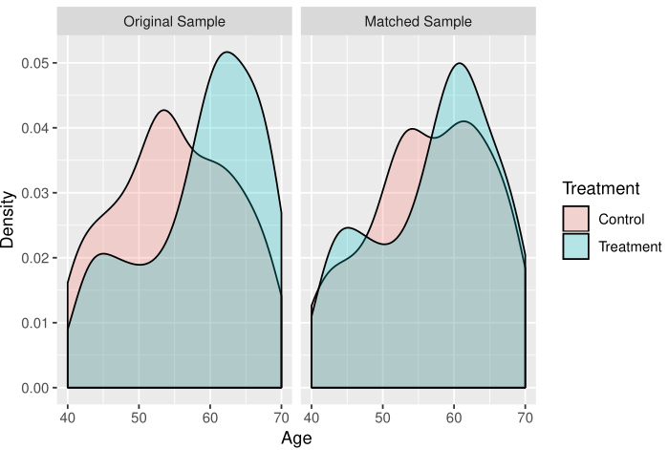
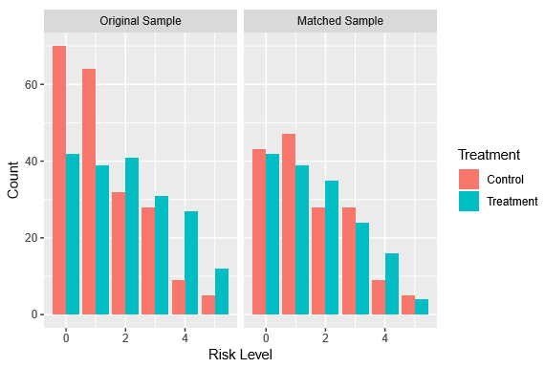
Balance Diagnostics Plot Examples
Using matched sample from before

Slide 32
5. Estimate Treatment Effect
Treatment effect estimation depends on propensity score method:
Matching: Estimated by comparing outcome between groups in matched sample
Stratification: Estimated for each strata and then pooled for overall treatment effect
IPTW: Estimated by comparing average weighted outcomes between treated group and control group.
Treatment effect is estimated from model coefficient of the treatment indicator variable
Additional significance testing and confidence intervals can be calculated using standard statistical methods.

Slide 33
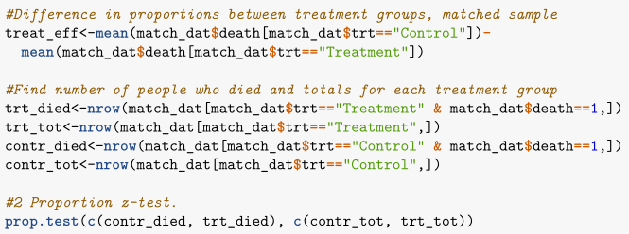
Treatment Effect Analysis Example
Using matched sample.
Controversy over whether to treat groups and independent or not. We treat them as independent here.
Proportion who survived was 7% higher in the untreated than the treated group,
Confidence interval is (-0.01, 0.15) so evidence that treatment works is inconclusive.

Slide 34
Alternative Method: Regression Covariate Adjustment
Use regression and adjust for each baseline covariate separately in the model.
Several limitations to this approach:
Harder to check regression goodness of fit diagnostics than propensity score balance diagnostics.
In regression the design of the study and analysis of treatment effect are integrated leading to possible bias in design by researchers.
Regression analysis is less effective when the outcome under study is rare or the treatment is common.

Slide 35
Limitations of Propensity Score Methods
Doesn’t always work well with small samples.
If one covariate is missing, propensity score will also be missing.
Only controls for measured covariates.

Slide 36
See Handout for References

